Slide 1

Introduction to Eclipse

Slide 2
Overview
What is Eclipse?
Advantages & Disadvantages
Prerequisites for Running Eclipse
How to Lunch Eclipse
Eclipse components
Creating a Workspaces / Projects
Creating Classes
Compiling and Running Code

Slide 3
What is Eclipse?
Eclipse is an integrated development environment (IDE) for developing applications using the Java programming language and other programming languages such as C/C++, Python, PERL, Ruby etc.
Open Source
  It is a general purpose open platform that facilitates and encourages the development of third party plug-ins
Integrated Development Environment (IDE)
  Provides tools for coding, building, running and debugging applications
Originally designed for Java, now supports many other languages
  Good support for C, C++
  Python, PHP, Ruby, etc…

Slide 4
Advantages
One user interface for many languages
Low cost
Platform independent IDE and applications
Support for all Java technologies & standards
Evolving rapidly
Disadvantages
Open source
Heavy hardware demands

Slide 5
Prerequisites for Running Eclipse
Eclipse is written in Java and will thus need an installed JRE or JDK in which to execute
  JDK recommended

Slide 6

Launching Eclipse
Once you have the environment setup, go ahead and launch eclipse
You should see the following splash screen…

Slide 7
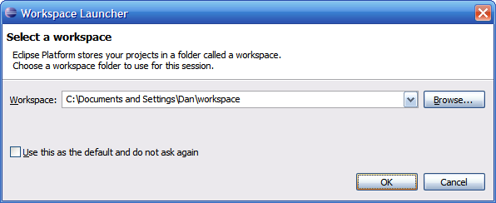
Selecting a Workspace
In Eclipse, all of your code will live under a workspace
A workspace is nothing more than a location where we will store our source code and where Eclipse will write out our preferences
Eclipse allows you to have multiple workspaces – each tailored in its own way
Choose a location where you want to store your files, then click OK

